Slide 1
LS-1101-2023
Membrane Transport

Slide 2
Transport across the cell membrane
Lipid bilayer

Slide 3
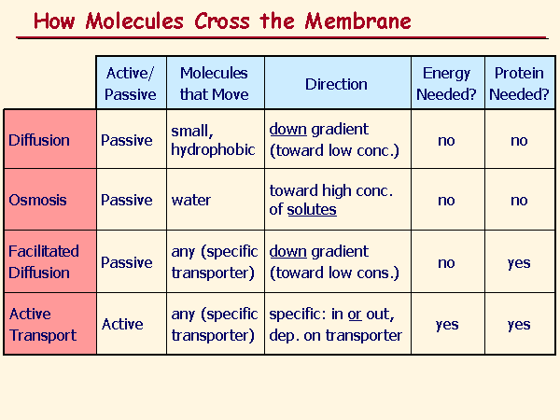

Slide 4
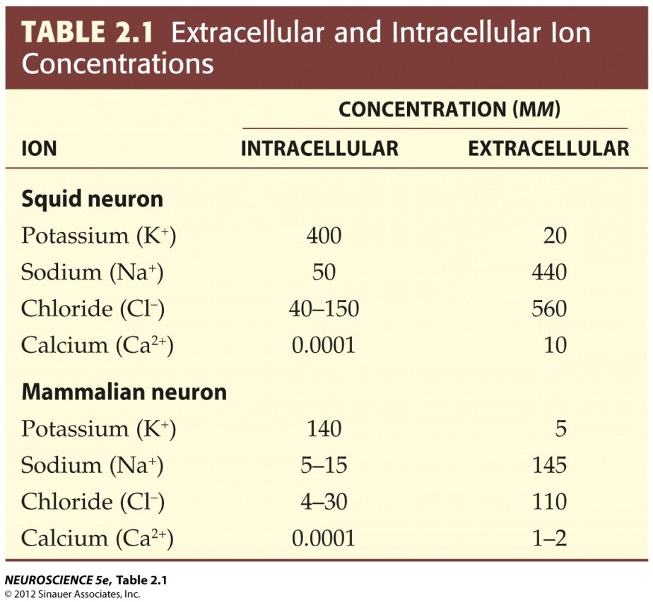

Slide 5
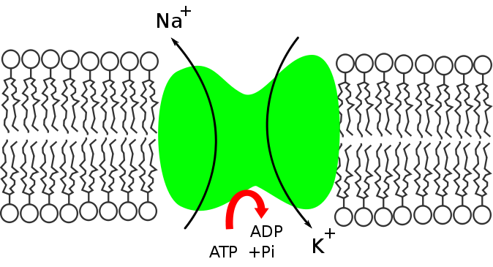
Co-transport: Na⁺- K⁺ Pump

Slide 6
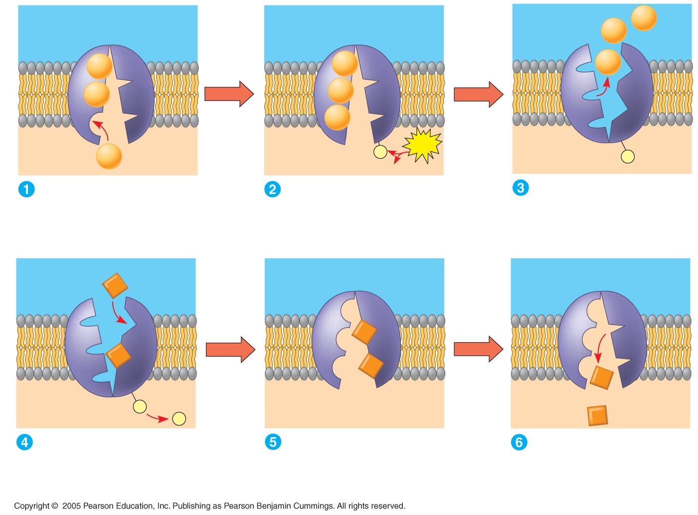
EXTRACELLULAR
FLUID
[Na⁺] high
[K⁺] low
Na⁺
Na⁺
Na⁺
Na⁺
Na⁺
Na⁺
Na⁺
Na⁺
[Na⁺] low
[K⁺] high
P
ATP
CYTOPLASM
Na⁺
P
ADP
Cytoplasmic Na⁺ bonds to
the sodium-potassium pump
Na⁺ binding stimulates
phosphorylation by ATP.
Phosphorylation causes
the protein to change its
conformation, expelling Na⁺
to the outside.
K⁺
K⁺
K⁺
K⁺
K⁺
P
K⁺
P
Extracellular K⁺ binds
to the protein, triggering
release of the phosphate
group.
Loss of the phosphate
restores the protein’s
original conformation.
K⁺ is released and Na⁺
sites are receptive again;
the cycle repeats.

Slide 7
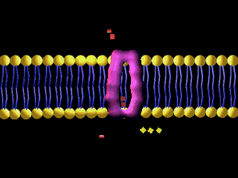

Slide 8
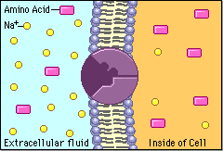

Slide 9
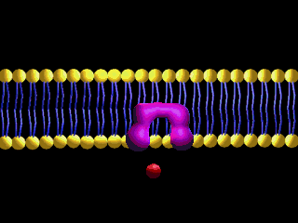

Slide 10
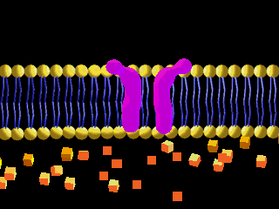
Channel mediated transport

Slide 11
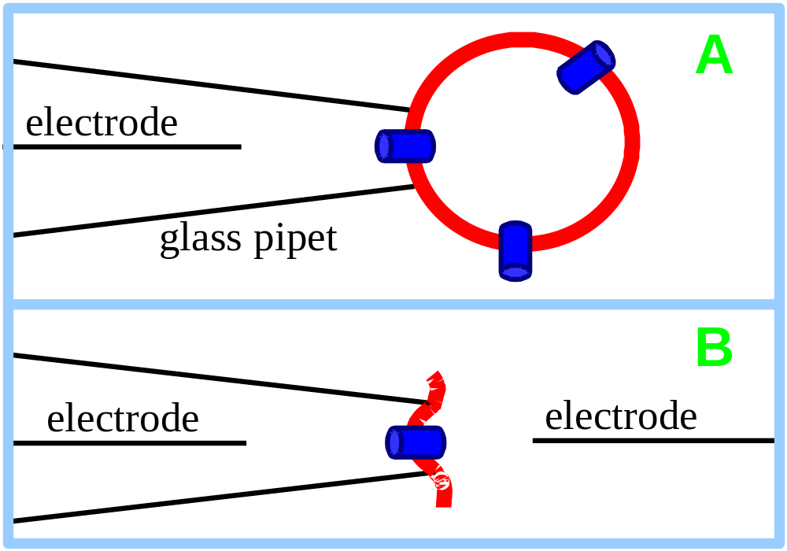
Patch Clamping
The technique of patch clamping is used to study ion channel activity.
A narrow bore micropipet may be pushed up against a cell or vesicle, and then pulled back, capturing a fragment of membrane across the pipet tip.

Slide 12
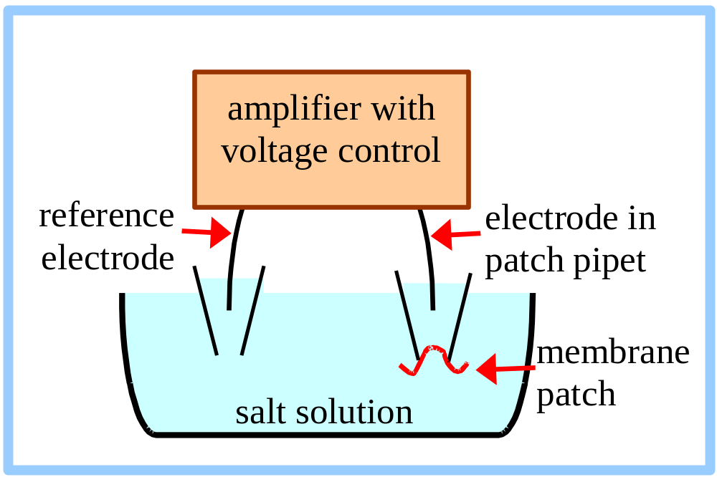
Patch Clamping
A voltage is imposed between an electrode inside the patch pipet and a reference electrode in contact with surrounding solution. Current is carried by ions flowing through the membrane.

Slide 13
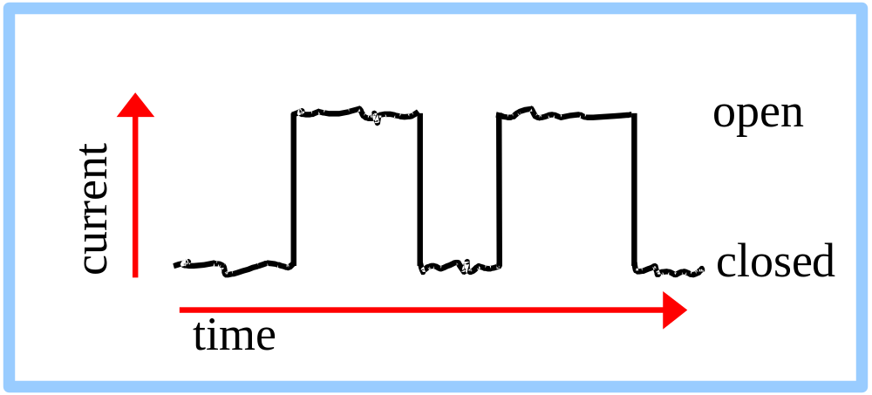
If a membrane patch contains a single channel with 2 conformational states, the current will fluctuate between 2 levels as the channel opens and closes.
The increment in current between open & closed states reflects the rate of ion flux through one channel.

Slide 14

Vesicle mediated transport

Slide 15
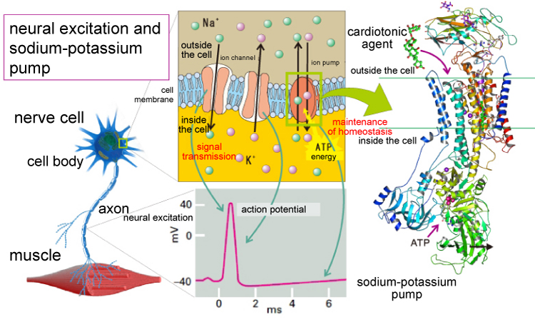
https://www.youtube.com/watch?v=oa6rvUJlg7o

